Slide 1











Integrative Machine Learning Approach for Forecasting Lung Cancer Chemosensitivity
From Algorithm to Cell Line Validation
Authors: Jinghong Chen, Yonglin Yi, Chunqian Yang, Haoxuan Ying, Jian Zhang, Anqi Lin, and Ting Wei
Journal: Computational and Structural Biotechnology Journal
Date: 2025-7-26
Sudarshan –AID25064
Naren – AID25034
  Vivek – AID25063
Sathvik – AID25057

Slide 2











Research Objective
Primary Goal
Develop a robust and accurate machine learning model capable of predicting the chemosensitivity of lung cancer patients.
Integrate Multi-omics Data
Combine genomic, transcriptomic, and clinical data to create a comprehensive predictive tool
Optimize Treatment Outcomes
Support personalized chemotherapy selection to improve patient prognosis
Validate Through Experiments
Confirm the model's effectiveness through computational and cell line validation
Identify Key Genetic Factors
Discover genetic markers influencing chemotherapy response in lung cancer
2/20

Slide 3











Lung Cancer Overview
Classification
Global Impact
Non-small Cell Lung Cancer (NSCLC)
Lung cancer ranks among the malignancies with the highest incidence and mortality rates
Most common type, accounts for about 80-85% of cases
Small Cell Lung Cancer (SCLC)
Global Statistics (2020)
Less common but more aggressive, accounts for about 15-20% of cases
2.2M
1.8M
New Cases
Deaths
3/20

Slide 4












Challenges in Chemotherapy Treatment
Inter-Patient Variability
Genetic Polymorphisms
Significant variation in patient responses to chemotherapeutic agents, making personalized treatment challenging
Genetic differences among patients affect drug metabolism and response efficacy
Tumor Heterogeneity
Drug Metabolism Variations
Genetic and phenotypic diversity within tumors leads to varied responses to treatment
Individual differences in drug metabolism pathways affect treatment outcomes
Clinical Practice Limitations
Reliance on empirical judgment with significant limitations
Difficulty in accurately predicting individual patient sensitivity
Risk of unnecessary toxic reactions and suboptimal treatment outcomes
4/20

Slide 5







Data Sources
GDSC Database
GEO Database
Provided RNA-seq data and drug IC50 values for cell lines.
Provided datasets for model validation and survival prediction.
GDSC1 and GDSC2 datasets for model training
Model Validation: 10 datasets with cell line RNA-seq data and drug sensitivity data
Focused on lung cancer-related cell lines
Included commonly prescribed chemotherapy drugs
Survival Prediction Validation: 5 datasets with patient RNA-seq data, clinical medication information, and survival data
Data Integration: Multi-omics and clinical data were systematically integrated to develop a comprehensive predictive model for lung cancer chemosensitivity.
5/20

Slide 6










Machine Learning Models Evaluated
The study evaluated a total of 45 different machine learning algorithms to predict lung cancer chemosensitivity, including various types of regression and classification models.
Support Vector Machine
Random Forest
Ridge Regression
Elastic Net
Powerful supervised learning model for classification and regression analysis that builds hyperplanes to distinguish data points.
Ensemble learning method that builds multiple decision trees and combines their results to improve prediction accuracy and stability.
Linear regression method that handles multicollinearity by adding an L2 regularization term to shrink regression coefficients.
Combines Lasso and ridge regression penalties, suitable for high-dimensional data with correlated features.
Lasso
Gradient Boosting Machine
plsRglm
XGBoost
Linear regression with L1 penalty that performs feature selection and model sparsity.
Ensemble technique that iteratively trains weak predictors (usually decision trees) to optimize the model.
Partial least squares regression suitable when predictors outnumber observations or when multicollinearity exists.
Efficient, flexible and portable gradient boosting framework that performs well on many machine learning tasks.
6/20

Slide 7










Methodology: Overall Workflow
Data Collection
Model Development
Clinical Validation
Experimental Validation
Multi-omics and clinical data from public databases
Validation using patient survival information
Training and validation of machine learning models
Cell line experiments to confirm findings
Multi-Stage Approach
Comprehensive collection of multi-omics data from GDSC and GEO databases
Clinical validation using 10 datasets containing cell line data
Systematic evaluation of 45 different machine learning algorithms
Additional validation with 5 datasets containing patient survival data
Cross-validation to assess model performance
In vitro cell line experiments to biologically confirm gene involvement
7/20

Slide 8





Methodology: Model Training
Data Source
Genomics of Drug Sensitivity in Cancer (GDSC) Database
RNA-seq data and drug IC50 values for cell lines
Data Splitting
Model Building
Random division of data into training and validation sets
IC50 prediction models based on gene expression data
Ratio: 7:3
Using cross-validation methods
Algorithm Selection
Model Evaluation
Evaluation of 45 different ML algorithms
Assessment of gene performance in contributing to the model
Including SVM, Random Forest, Ridge Regression, etc.
Calculation of correlation coefficient (R) between predicted and actual IC50 values
Optimal Model Selection
Model with the highest mean R-value for each drug was selected as the optimal predictor
8/20

Slide 9












Methodology: Clinical Validation
Validation Datasets
Analysis Approach
Cell Line Data
Model Application
10 datasets from GEO with RNA-seq and drug sensitivity data
Applied optimized prediction models to estimate IC50 values
Patient Data
Patient Stratification
5 datasets with RNA-seq, clinical medication info, and survival data
Used optimal cutoff method to classify patients as sensitive or resistant
Clinical Validation Workflow
Data Preparation
Model Evaluation
Survival Analysis
Load and preprocess RNA-seq and drug sensitivity data from GEO
Compare estimated IC50s between drug-sensitive and drug-resistant groups
Generate Kaplan-Meier curves to analyze survival differences
9/20

Slide 10













Methodology: Cell Line Experiments
Cell Lines & Treatment
Experimental Workflow
Cell Lines Used:
siRNA-mediated Knockdown
NSCLC (NCI-H460)
NSCLC (PC-9)
NSCLC (NCI-H1299)
Silencing of TMED4 and DYNLRB1 genes identified in the machine learning model
SCLC (NCI-H1339)
Drug Treatment
Chemotherapeutic Agents:
Exposing cells to varying concentrations of chemotherapeutic agents
Cisplatin (DDP)
Etoposide (VP-16)
Cell Viability Assessment
Gemcitabine (GEM)
Epirubicin (EPI)
Using CCK-8 colorimetric assay to measure cell viability after 48 hours
5-Fluorouracil (5-FU)
Data Analysis
Nonlinear regression to generate drug concentration-cell viability curves
Calculation of IC50 values to evaluate chemosensitivity changes
10/20

Slide 11













Results: Best Performing Model
Integrated Model Excellence
An integrated model combining Random Forest (RF) and Support Vector Machine (SVM) algorithms demonstrated superior performance in predicting lung cancer chemosensitivity.
Random Forest
Support Vector Machine
Integrated Model
Superior Performance
Robustness
Optimal predictive capabilities across both training and validation datasets
Consistent performance indicates reliability in forecasting chemosensitivity
Comprehensive Analysis
Foundation for Discovery
Evaluated 45 different machine learning algorithms to identify the best approach
Provided basis for identifying key genetic factors in chemotherapy response
11/20

Slide 12





Results: Key Predictive Genes
Machine learning model identified two pivotal genes associated with lung cancer chemosensitivity:
TMED4
DYNLRB1
Key Findings:
Key Findings:
Significantly higher expression in chemotherapy-resistant samples
Significantly higher expression in chemotherapy-resistant samples
Critical role in mediating drug resistance
Associated with cellular response mechanisms
Strong predictor of treatment outcomes
Correlates with patient survival outcomes
Expression Level Comparison
Expression Level Comparison
Sensitive
Sensitive
Resistant
Resistant
Significance: These genes serve as potential biomarkers for predicting chemotherapy response and may represent novel therapeutic targets.
12/20

Slide 13









Results: Survival Analysis Findings
Key Finding
Patients predicted to be chemotherapy-sensitive showed significantly improved overall survival compared to resistant cases.
Conceptual Survival Curve Comparison
Sensitive
Resistant
Clinical Significance
The model effectively stratifies patients based on their likely response to treatment
Prognostic Value
Findings provide valuable prognostic information for personalized treatment decisions
13/20

Slide 14









Results: Gene Knockdown Effects
siRNA-mediated Gene Silencing
TMED4 and DYNLRB1 expression was successfully reduced in lung cancer cell lines
Cell Line Analysis
Drug Response Effects
siRNA knockdown confirmed gene expression reduction
Increased sensitivity to cisplatin (DDP)
Enhanced chemosensitivity observed in treated cells
Enhanced response to etoposide (VP-16)
Significant difference in drug response compared to control groups
Improved chemosensitivity across multiple drug classes
Significance of Findings
TMED4
DYNLRB1
Genetic intervention led to enhanced chemosensitivity, directly supporting the role of these genes in mediating chemotherapy resistance
14/20

Slide 15













Results: Validation Across Drug Types
Model Performance Across Chemotherapeutic Agents
The machine learning model demonstrated consistent predictive ability across various drug classes used in lung cancer treatment.
Cisplatin (DDP)
Etoposide (VP-16)
Predicted response correlates with experimental validation
Consistent predictive performance across cell lines
Gemcitabine (GEM)
Epirubicin (EPI)
Robust prediction across diverse lung cancer cell types
Model shows consistent accuracy in predicting response
5-Fluorouracil (5-FU)
Validation confirms model's versatility across drug mechanisms
Consistent predictive performance across all drug classes
15/20

Slide 16
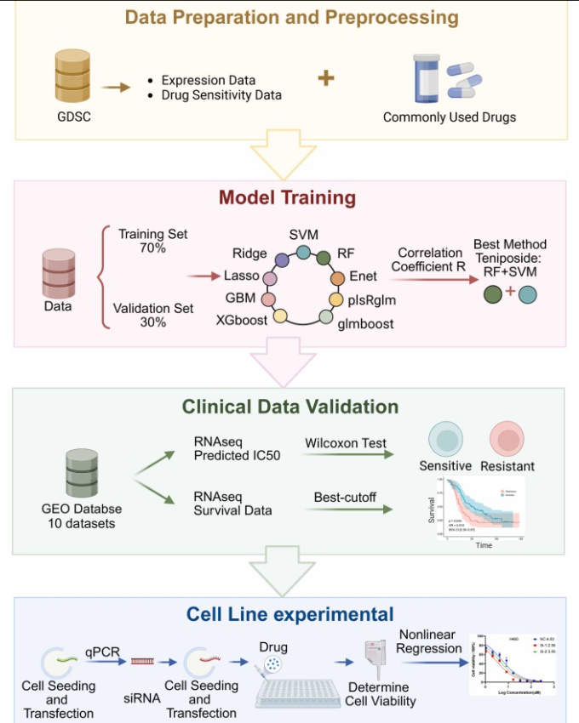
Results : overview
16/20

Slide 17







Discussion: Biological Significance
Key Genes Identified
TMED4 and DYNLRB1 exhibit higher expression in chemotherapy-resistant lung cancer cells
Functional Validation
Therapeutic Potential
siRNA-mediated knockdown of TMED4 and DYNLRB1 enhanced chemosensitivity, confirming their role in mediating resistance
Genetic interference with these genes could serve as a novel approach to overcome drug resistance in lung cancer
Biological Insights
The identified genes are involved in cellular mechanisms that regulate drug response
Expression levels correlate with patient survival outcomes
These genes represent potential biomarkers for treatment response prediction
Clinical Implications
Targeting TMED4 and DYNLRB1 could enhance treatment efficacy and overcome resistance mechanisms, offering new avenues for personalized lung cancer therapy.
17/20

Slide 18








Discussion: Clinical Applications
Clinical Impact
LC-DrugPortal: Online Prediction Tool
Personalized Chemotherapy
Assists clinicians in creating more precise and personalized chemotherapy plans
A user-friendly web application developed to facilitate clinical implementation of our machine learning model.
Improved Outcomes
Clinical Workflow Integration
Enhances treatment effectiveness while reducing unnecessary toxic side effects
Step 1: Input patient data and drug information
Avoiding Trial and Error
Step 2: Receive personalized drug sensitivity predictions
Predicts patient responses to specific chemotherapy drugs, avoiding ineffective treatments
Step 3: Make informed treatment decisions
Promotes precision medicine for lung cancer patients
18/20

Slide 19









Discussion: Limitations and Future Directions
Limitations
Future Directions
Retrospective Data
Gene Interaction Studies
Model primarily trained and validated on retrospective data, requiring independent validation in larger prospective clinical cohorts
Further explore interactions between identified genes and other molecular mechanisms, considering their role in chemotherapy resistance
Complex Resistance Mechanisms
Multi-Omics Integration
Lung cancer chemotherapy resistance is complex and may involve more biomarkers and signaling pathways not yet discovered
Integrate more data dimensions including proteomics, metabolomics, and patient immune microenvironment information
Data Integration Challenges
Clinical Implementation
Limited integration of multi-dimensional data types despite efforts to combine genomics, transcriptomics, and clinical information
Deep integrate with clinical decision support systems and conduct clinical trials to assess actual improvement in patient outcomes
19/20

Slide 20












Conclusion
High-Performance Model
Key Genes Identified
Successfully developed a machine learning model integrating multi-omics and clinical data
Identified TMED4 and DYNLRB1 as pivotal genes in chemotherapy resistance
Demonstrated superior predictive capabilities for lung cancer chemosensitivity
Revealed higher expression levels in chemotherapy-resistant samples
Achieved accurate prediction of chemotherapy response
Validated through cell line experiments showing enhanced chemosensitivity when genes were silenced
Clinical Impact
Future Directions
Provides a valuable tool for personalized chemotherapy selection
Further validate in larger clinical cohorts
Explore functional mechanisms of identified genes
Supports precision oncology through objective prediction of drug response
Integrate with clinical decision support systems
Offers new biological insights into drug resistance mechanisms
20/21

Slide 21










References
Primary Article
Chen, J., Yi, Y., Yang, C., Ying, H., Zhang, J., Lin, A., & Wei, T. (2025). Integrative machine learning approach for forecasting lung cancer chemosensitivity: From algorithm to cell line validation. Computational and Structural Biotechnology Journal, 23, 10.1016/j.csbj.2025.07.043.
Key Data Sources
Genomics of Drug Sensitivity in Cancer (GDSC) Database
Gene Expression Omnibus (GEO) Database
10 datasets containing cell line RNA-seq data and drug sensitivity data (e.g., GSE106609, GSE116192, GSE162256, etc.) for model validation.
Provided RNA-seq data and drug IC50 values for cell lines, including GDSC1 and GDSC2 datasets used for model training.
Statistical Analysis Tools
Experimental Validation
R software (version 4.3.0) and Python programming language (version 3.9.5) with specific packages for data analysis and visualization.
Cell line experimental data analysis using GraphPad Prism software (version 9.0) for fitting drug concentration-cell viability curves.
21/21

